Slide 1

JavaScript on the server. A Node.js crash course
Julian Nalenz
Valentin Dimov
Robert Dillitz

Slide 2
What is Node.js?
asynchronous event driven JavaScript runtime
using non-blocking I/O model
designed to build scalable network applications
built on Google’s V8 JavaScript engine
free & open source

Slide 3
Why use Node.js?
single threaded event loop model
to “javascriptify” the whole stack
has become THE standard environment for JS-related tools
synergizes well with an agile development style
tons of available packages through npm

Slide 4
When (not) to use Node.js?
YES
I/O Bound Applications
Data Streaming Applications
Data Intensive Real-time Applications (DIRT)
JSON API Based Applications
Single Page Applications
NO
Applications that require heavy computational power

Slide 5
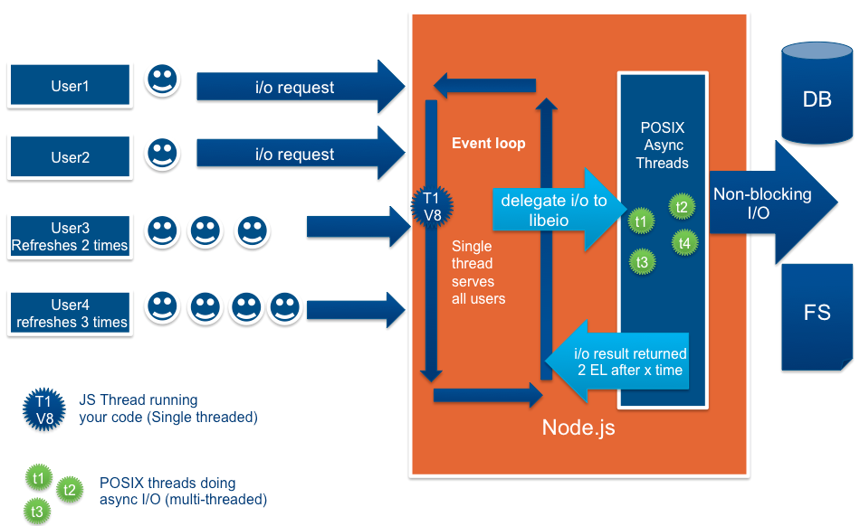
How does Node.js work?

Slide 6
What is a callback?
function that is passed as an argument and called upon completion
all Node.js APIs support callbacks
used to produce non-blocking code
last argument of the API call
first argument of callback function is used for error handling

Slide 7
Blocking vs. Non-Blocking
const fs = require('fs');
fs.readFileSync('./file.md', (err, data) => {
if (err) throw err;
console.log(data);
});
fs.unlinkSync('/file.md');
const fs = require('fs');
fs.readFile('./file.md', (readFileErr, data) => {
if (readFileErr) throw readFileErr;
console.log(data);
fs.unlink('/file.md', (unlinkErr) => {
if (unlinkErr) throw unlinkErr;
});
});

Slide 8
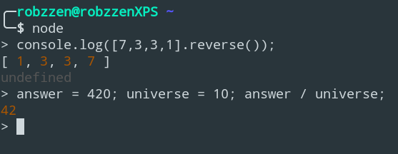
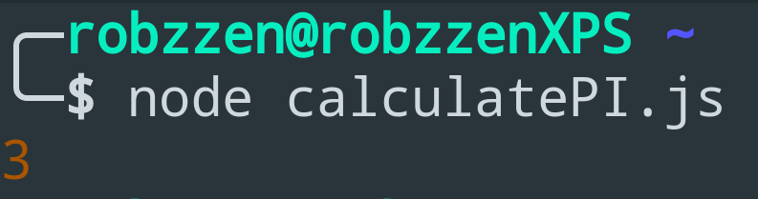
How to use Node.js?
start REPL with node
run programs with node <filename>
file naming conventions:
filenames end with .js
main file is called index.js, app.js or server.js

Slide 9
The Node.js ecosystem

Slide 10
NPM - Node Package Manager
Utility to install, update and manage dependencies of Node packages
Online searchable repository: npmjs.org
Available as a command line utility
Pre-packaged into Node.js since version 0.6.3

Slide 11
package.json
Describes project properties
name
version
description
main
scripts
...
Located in the root directory of the project
Used by npm to locate the project directory
Utility to create it automatically: npm init

Slide 12
Other npm utilities
npm install <module name> [--save-prod/--save-dev/--save-optional/--no-save]
Install a package from the online repository
Default: install locally (in node_modules/)
-g: Install globally
The last option is whether to update the dependency data in package.json
npm uninstall <module name>

Slide 13
Other npm utilities
npm ls [-g] - List (globally) installed packages
npm search <module name> - Search for a module in the repository
npm adduser - npm will prompt for a username, password, and email.
If you are already registered, this will function as a login
Otherwise, it will register a new user
Identical to npm login
npm publish - After you’re logged in, publish your module

Slide 14
Gulp
Tool for automating tasks (build-related or otherwise), similar concept to make
Executes a gulpfile, (usually) written in JavaScript
Installable as npm packages: gulp-cli (global), gulp (local/global)
Offers a rich API, accessible by require(‘gulp’)
{src, dest, watch, series, parallel} = require(‘gulp’);

Slide 15
Gulpfile
Can be implemented as:
gulpfile.js (Gulpfile.js) in the project’s directory
gulpfile.js/index.js (gulpfile.js is a directory)
In principle, it’s just JavaScript - it can be split in modules or import modules
Other languages can also be used (with a transpiler module)
Exported functions (the exports object) are the public tasks Gulp can execute
exports.default = default task
Execution: gulp <Task1> <Task2> … in the project directory

Slide 16
Tasks, asynchronicity, and the Gulp API
Tasks must be compatible with asynchronous completion
async or return a promise, stream, event emitter or a child process
Alternatively, accept an error-first callback as a parameter
This allows tasks to be composed, using the series() and parallel() functions
series() : The tasks are completed one after the other
parallel() : The tasks may be processed in a quasi-parallel manner
Both can be arbitrarily nested:
exports.doSth = series(parallel(A, series(B,C)),D)

Slide 17
More on the Gulp API: Working with files
“Globs” : Expressions (or an array of expressions) that match filenames
Separator is always /, even in Windows
* : Any sequence of characters in a single file/directory name
** : Any sequence of characters in the entire path (across separators)
\\ : Escape character (for wildcards)
! : When evaluating an array of globs, remove matching paths from the already collected ones

Slide 18
More on the Gulp API: Working with files
src(glob): Reads the files matching the glob into a readable Node stream
dest(path): Writable Node stream to the specified path. Re-emits the data it’s given to allow piping
s1.pipe(s2): s1’s output -> s2’s input (can be chained)
Example using the gulp-babel transpiler plugin:
exports.default = function() {
return src(‘src/*.js’).pipe(babel())
.pipe(dest(‘output/’)); }

Slide 19
More on the Gulp API: Plugins and file watchers
Plugins: Receive input, transform it, emit output
Used with pipe()to transform files
Renaming files, transpilation, minifying, etc.
Available as npm packages
watch(glob, task) : Execute a task as soon as one of the matching files is added, deleted or changes

Slide 20
Webpack
Widely used tool for bundling JavaScript modules
NPM packages: webpack-cli, webpack
Highly configurable, supports a wide range of activities
Plugins allow highly specific activities to be easily integrated into the process.
Usage: npx webpack [--config <config filename>]

Slide 21
Webpack: Bundling your application
The configuration file specifies:
Entry points: Which files will be the roots of the dependency graph?
Output: Where to emit the completed bundles?
Loaders: How should specific types of files be handled?
Plugins: Used for more specific tasks
Mode: Governs use of webpack’s built-in optimizations

Slide 22
webpack.config.js
const webpack = require(‘webpack’);
module.exports = {
entry: … //entry points
output: … //outputs
module: … //loaders
plugins: … //plugins
mode: … //mode
};

Slide 23
Webpack configuration basics
Entry point
By default it’s ./src/index.js, but different path(s) can be specified.
Output
Defaults to ./dist/main.js for the main output file and ./dist for the others
Format: {path: (ABSOLUTE path), filename: …}
The path module can be used to resolve the absolute path
Mode
‘production’, ‘development’ or ‘none’

Slide 24
Webpack configuration basics
Loaders: allow webpack to process formats other than JavaScript and JSON
Syntax:
module: {
rules: [
{test: /\.txt$/, use: ‘raw-loader’}
]
}

Slide 25
Webpack configuration basics
Plugins
Integrate into the bundling process and do anything a loader can’t do.
Used as instances, can be initialized many times with different parameters
plugins: [
new pluginName(pluginOptions);
…
]

Slide 26
Express
Lightweight, flexible framework for building web apps
NPM module: express
Development can focus on the application logic
Support for a wide array of plugins
body-parser: For parsing encoded form data (e.g. from a POST request)
cookie-parser: For parsing cookies
etc.

Slide 27
Express apps: Creation and request handling
Loading Express: const express = require(‘express’);
Creating an app: let app = express();
Registering routes for HTTP requests:
app.get(url, function (req, res){...});
app.post(url, function (req, res){...});
req = object containing request data (e.g. form fields)
res = object containing response functions (send(), sendfile(), end(), …)
Starting the server: let server = app.listen(port, callback)

Slide 28
Express apps: Handling forms
GET method: Data in req.query.<field name>
POST method: Data is in the body. In case of URL-encoded data, we can use the body-parser middleware:
const bodyParser = require(‘body-parser’);
let urlencodedParser = bodyParser.urlencoded();
app.post(‘/form’, urlencodedParser, function(req, res) {
fieldData = req.body.fieldName;
});

Slide 29
Express apps: Other middlewares
express.static: Serve static content
app.use(express.static(dirName));
Files in this directory will be served as static pages
cookie-parser: Parse cookies in the request object
const cookieParser = require(‘cookie-parser’);
app.use(cookieParser());
app.get(‘/’, function(req, res) {
console.log(“Cookies: “, req.cookies);
});

Slide 30
Hapi
Another framework for web apps
NPM package hapi
Similarly focused on abstracting from infrastructure
Built-in support for routing, basic logging, parsing request data, cookies, …
Plugins add additional functionality: Authentication, better logging, serving static pages, etc.

Slide 31
Hapi: Creating a server
const Hapi = require(‘hapi’);
const server = Hapi.server({
port: 8080,
host: ‘localhost’
});
server.start() will then start the server (async function)

Slide 32
Hapi: Adding routes
server.route({
method: ‘GET’,
path: ‘/’,
handler: (request, h) => {
return ‘Hello, world!’;
}
});
Alternative: return h.response(‘Hello world!’);

Slide 33
Hapi: Adding routes
The route requires a method (or an array of them), a path and a handler
The path can be generalized, e.g. ‘/{username}’
Later available in request.params
The handler is an async function that accepts:
A request object, containing the HTTP request data
request.query = GET field values
request.payload = POST field values
A response toolkit, containing functions for the response

Slide 34
Hapi: Plugins
A plugin is an object that contains a name and a register function
register: async function (server, options) {...}
server.register(plugin, options) will add the plugin to the server.
The plugin might add additional functionality to the server, e.g. static pages
await server.register(require(‘inert’));
…
handler: (request, h) => { return h.file(...); }
Or it could really do anything...

Slide 35
Hapi: Cookies
Configuring a cookie: server.state(name, options)
Some options: encoding, ttl, isSecure, isHttpOnly, …
In a route’s handler, the cookie can be used:
Setting: h.state(name, value);
Getting: cookieValue = request.state.cookieName;
Clearing: h.unstate(name);

Slide 36
Project status

Slide 37
The Bayesian Survival Analysis approach
Statistical model, based on the idea of a hazard rate - the instantaneous probability of an event occuring (i.e. death).
The hazard rate is related to the survival function (the probability of the event not occurring up to a certain point in time).
The goal is to determine a base hazard rate and the influence of different parameters on it, e.g. gender, marital status, titles, etc.

Slide 38
Cox’s proportional hazards model
Assumption: The presence of a certain property influences the hazard rate proportionally, e.g. increase by 20%, decrease by 50%, etc.
In the case of continuous values, the influence is assumed to be exponential (for every further lover, the risk increases by another 10%)

Slide 39
About the model
A few nice things…
Easy to describe “what the model is thinking” - for any parameter, a number expresses its influence on the risk (e.g. 1.4 for 40% increase)
The survival function can be translated into an expected survival time.
And a few not-so-nice things
One needs a good prior guess for the base hazard rate
In the case of our small dataset, properties need to be “condensed”
Too many alive characters (censored inputs) in the dataset

Slide 40
Realization: Data input
For the characters, the age (or the lifetime, if dead) is considered
A JavaScript program extracts properties from the mined data and formats it into a form usable by the training script
Unusable characters are filtered out
There turned out to be a lot of these: About 300 characters have a death date, but no birth date

Slide 41
Realization: Model
To implement our model, we used Python’s pymc3 library (MCMC simulation)
The structure is mostly derived from an article on pymc3’s website, adapted to allow for multiple properties
After training, the model gives samples for base hazard and coefficients
Samples for the survival functions for any character

Slide 42
Realization: Model output
The output of the Python script is a JSON file, which contains:
Model parameters (base hazard, coefficients, considered properties)
For each character:
Properties (name, alive/dead, age)
Descriptions of the survival function (incl. expected survival time)
This output can be condensed down to a single prediction, if needed
Predictions for dead characters can serve as a measure of accuracy

Slide 43
Results
So far, the model’s predictions are still fairly broad and often overestimate characters’ lifespans
Possibly due to large amount (ca. 70%) of censored inputs
Better priors? Better choice of parameters?
Absolute time instead of time relative to birth date?
The JavaScript formatter is yet to be fully adapted to the new TV show data
The new data offers some potentially useful parameters

Slide 44
The Neural Network approach
used ML library: Keras
has a TensorFlow backend
allows training and predicting on the GPU for optimal speed
Open Source, Python
“was developed with a focus on enabling fast experimentation”
in our project: densely connected layers only

Slide 45
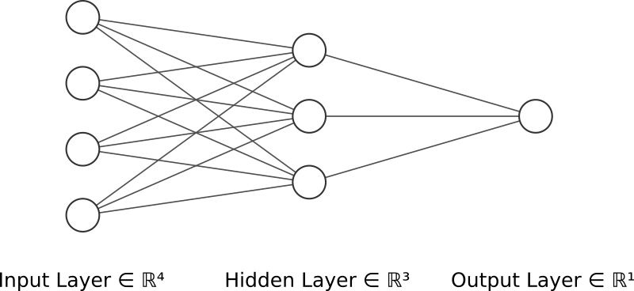
Basics of neural networks
mathematical abstraction of neurological data processing
input and output data are vectors of real numbers
feedforward through the layers is matrix multiplication
activation function used in neurons to model their action potential
learning using an optimizer (backpropagation)

Slide 46
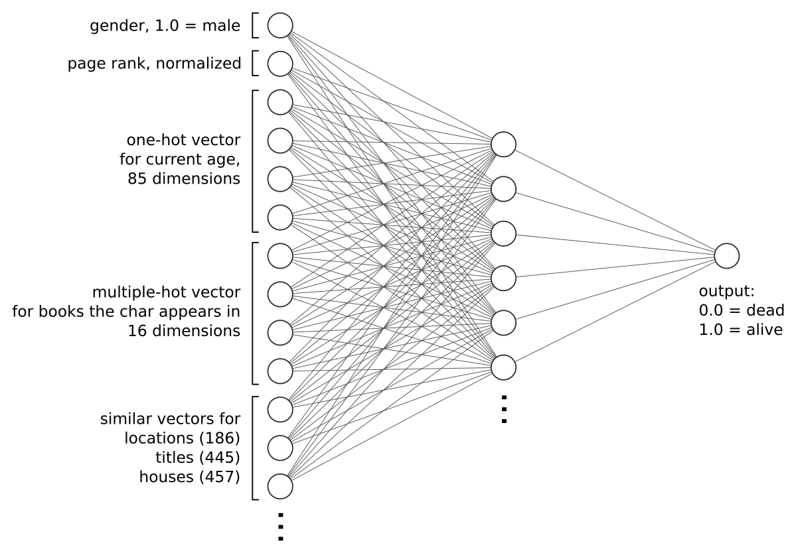
Our model for the book data

Slide 47
Other model considerations
current age input is arbitrary
possibility to expand training data considerably
predictions for transitioning PLOD over time can be determined
alternative architecture: output as one-hot vector corresponding to the number of years the character has left to live

Slide 48
Results
Year | PLOD
300 | 0.43 %
301 | 3.14 %
302 | 5.08 %
303 | 45.75 %
304 | 87.46 %
305 | 96.83 %
306 | 98.58 %
307 | 99.78 %
308 | 99.74 %
309 | 99.89 %
310 | 99.91 %
book data ends in year 300
example predictions for Jon Snow
threshold for longevity needs to be discussed
with the alternative architecture: output is probability for each number of years to go
needs to be improved, as somewhat illogical results appear frequently

Slide 49
Outlook
lack of training data → validation is barely possible
old book data: 285 alive, 163 dead (expandable to about 15k)
current show data: 14 alive, 14 dead
evaluating methods to determine model performance anyway
providing prediction data to other groups via minimalistic NPM module
for the curious: jstnineteen-groupb-got-predictions

Slide 50
Sources
Michael A. Nielsen, Neural Networks and Deep Learning, Determination Press, 2015
Keras Documentation. Retrieved March 26, 2019 from https://keras.io
Survival analysis: https://docs.pymc.io/notebooks/survival_analysis.html (retrieved March 28, 2019)
PyMC3 API: https://docs.pymc.io/api.html (retrieved March 28, 2019)
https://gotdata.northeurope.cloudapp.azure.com/api (retrieved March 28, 2019)
NumPy reference: https://docs.scipy.org/doc/numpy/reference/ (retrieved March 28, 2019)
Webpack: https://webpack.js.org/concepts (retrieved March 28, 2019)
Express.js: https://expressjs.com/en/api.html and https://www.tutorialspoint.com/nodejs/nodejs_express_framework.htm (retrieved March 28, 2019)
Gulp: https://gulpjs.com/docs/en/getting-started/quick-start (retrieved March 28, 2019)
Hapi: https://hapijs.com/tutorials (retrieved March 28, 2019)
NPM: https://docs.npmjs.com/cli-documentation/ and https://www.tutorialspoint.com/nodejs/nodejs_npm.htm (retrieved March 28, 2019)
Node.js tutorial: https://www.tutorialspoint.com/nodejs/ (retrieved March 28, 2019)

Slide 51
More sources
Node.js event loop:
https://blog.logrocket.com/a-complete-guide-to-threads-in-node-js-4fa3898fe74f (both retrieved March 28, 2019)
https://codeburst.io/how-node-js-single-thread-mechanism-work-understanding-event-loop-in-nodejs-230f7440b0ea
Why and when to use Node.js:
https://www.netguru.com/blog/use-node-js-backend (retrieved March 28, 2019)
Blocking vs Non-Blocking:
https://nodejs.org/en/docs/guides/blocking-vs-non-blocking/ (retrieved March 28, 2019)
https://alligator.io/nodejs/event-driven-programming/ (retrieved March 28, 2019)

